Slide 1

Plane Crashes
Team No. 4
Amit Shendge, Disha Kacha, Saniya Shinde, and Rachel Culbreath

Slide 2
What does our data tell us?
SEVERITY | SAFETY_SCORE | DAYS_SINCE_INSPECTION | TOTAL_SAFETY_ COMPLAINTS
CONTROL_METRIC | TURBULENCE_IN_ GFORCE | CABIN_TEMPERATURE | ACCIDENT_TYPE_CODE
MAX_ELEVATION | VIOLATIONS | ADVERSE_WEATHER_ METRIC | ACCIDENT_ID

Slide 3
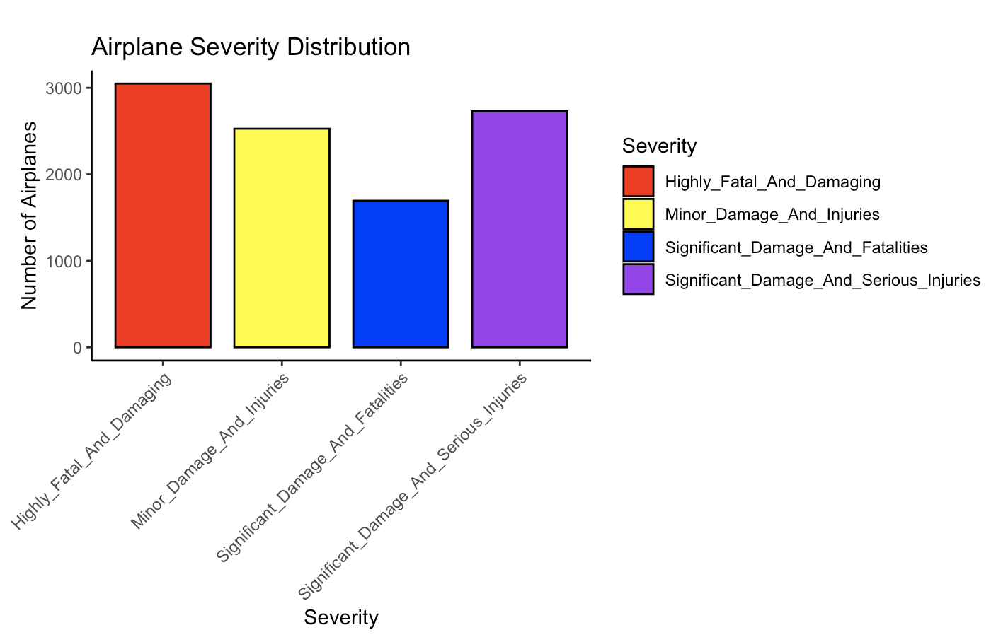
Severity Bar Chart

Slide 4
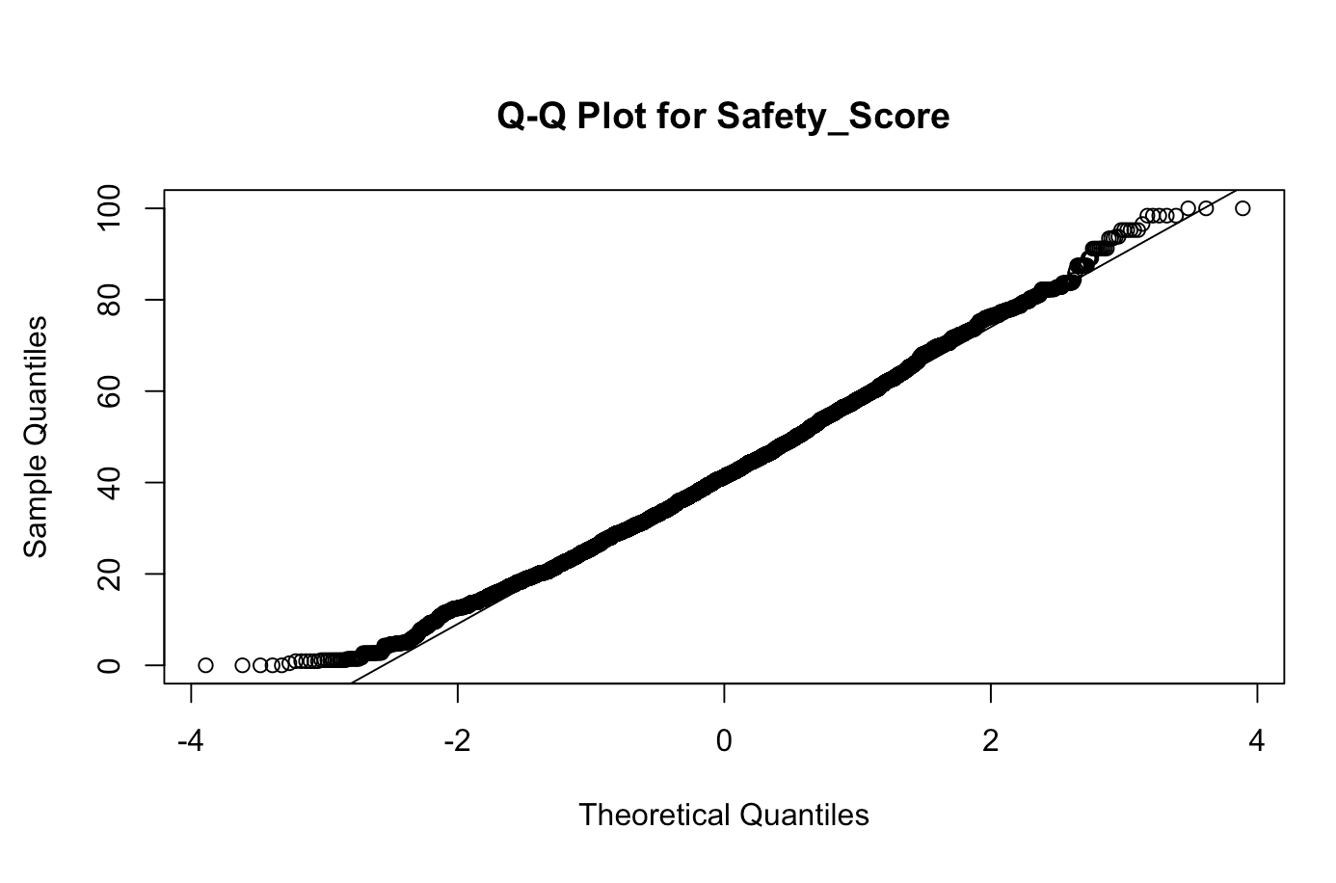
Q-Q Plot of Safety_Score

Slide 5
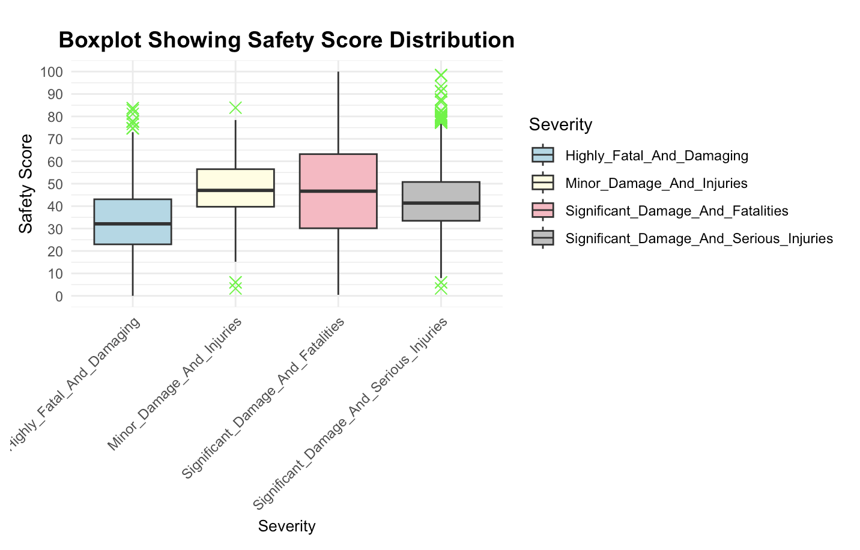
Safety Score

Slide 6
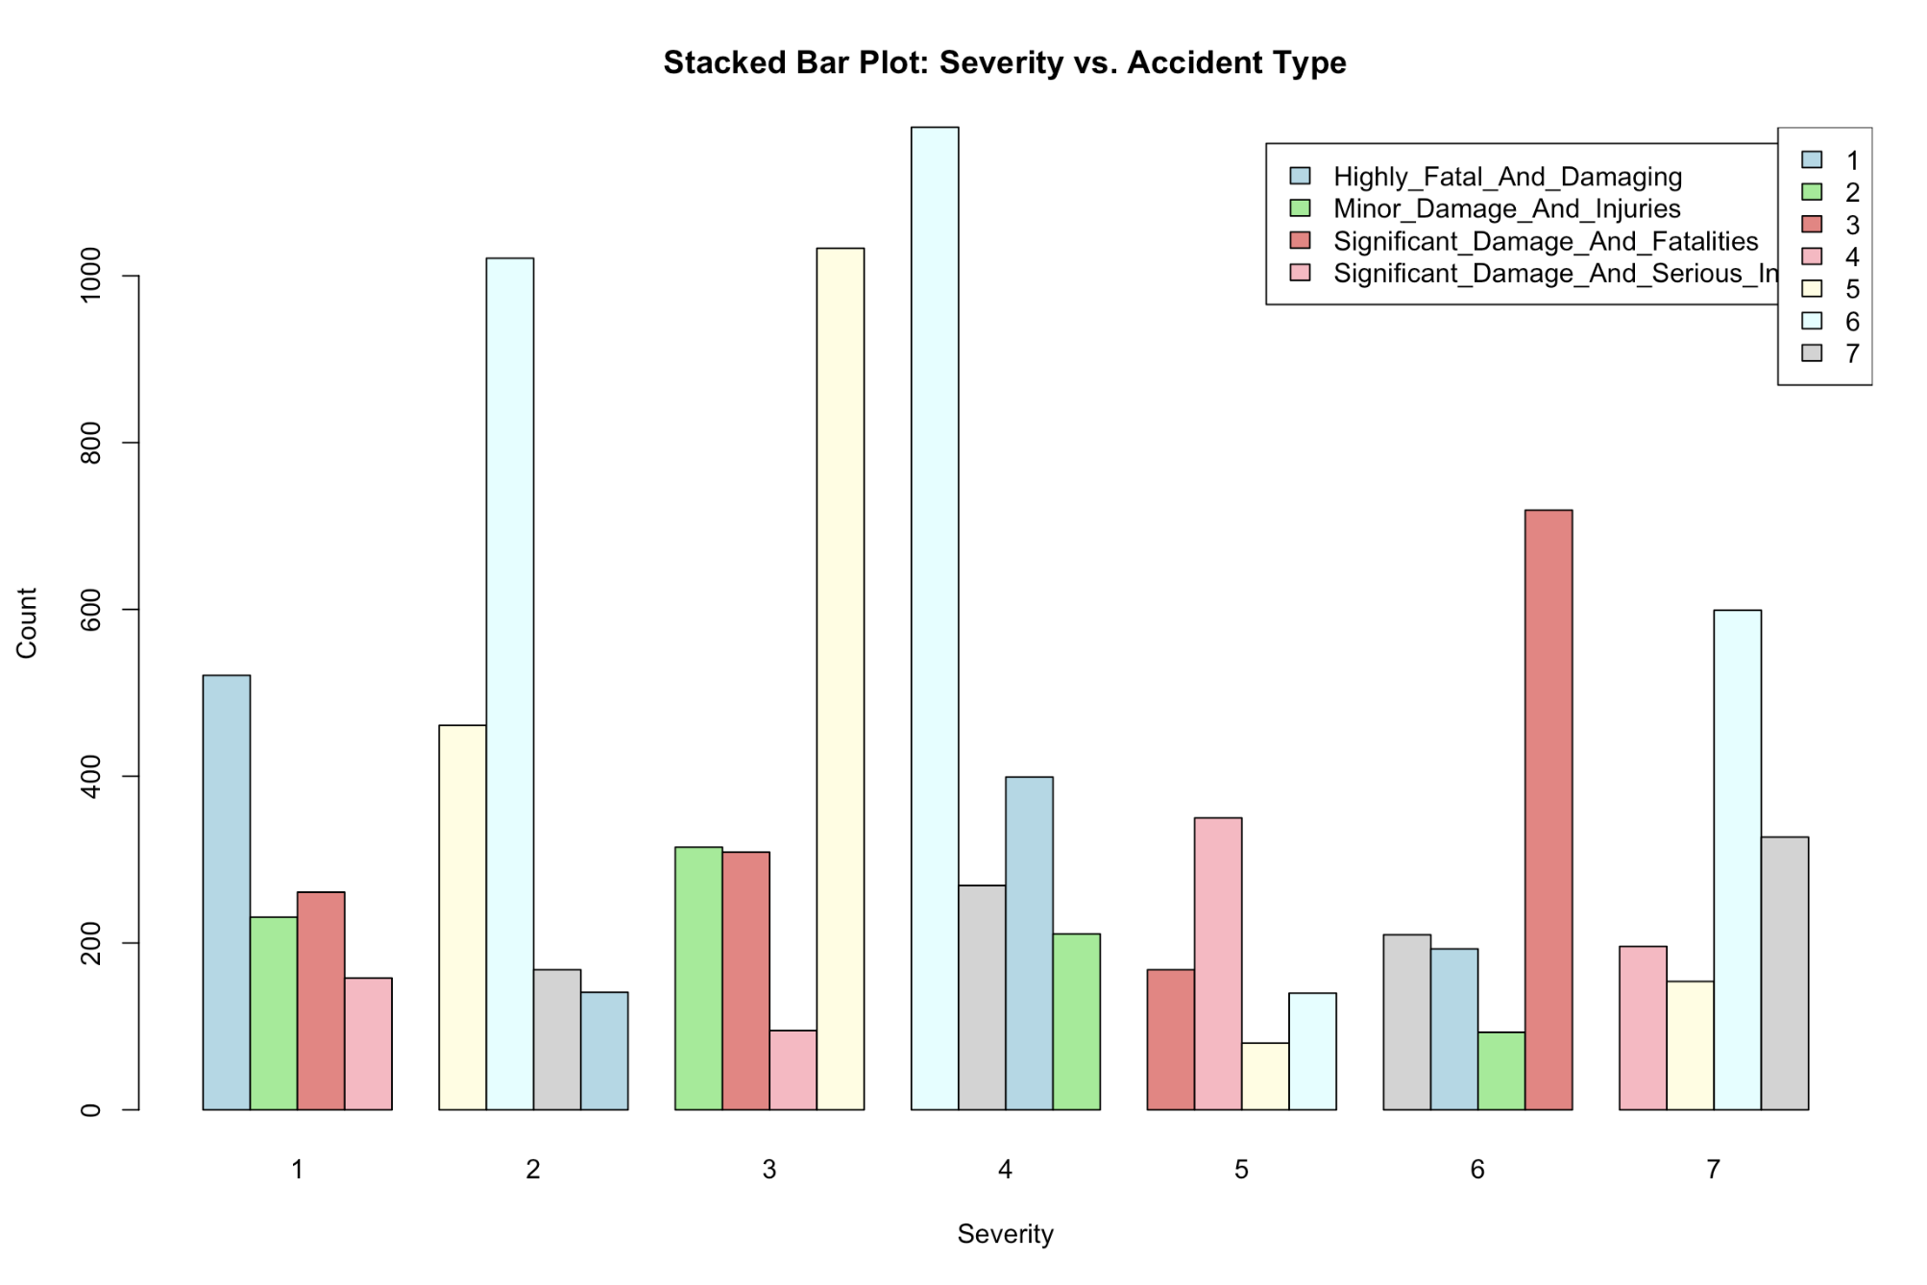
Severity vs. Accident Type

Slide 7
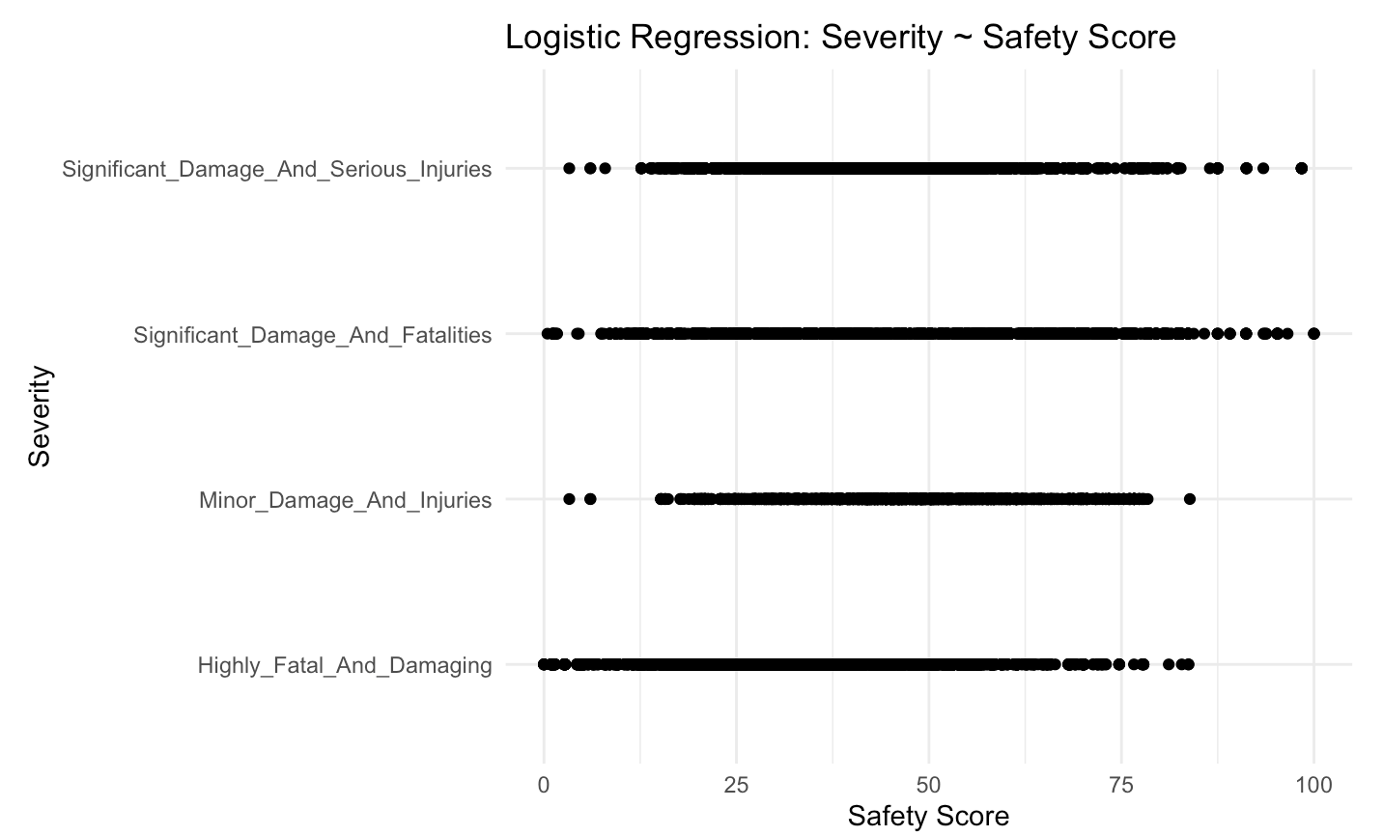
Logistic Regression

Slide 8
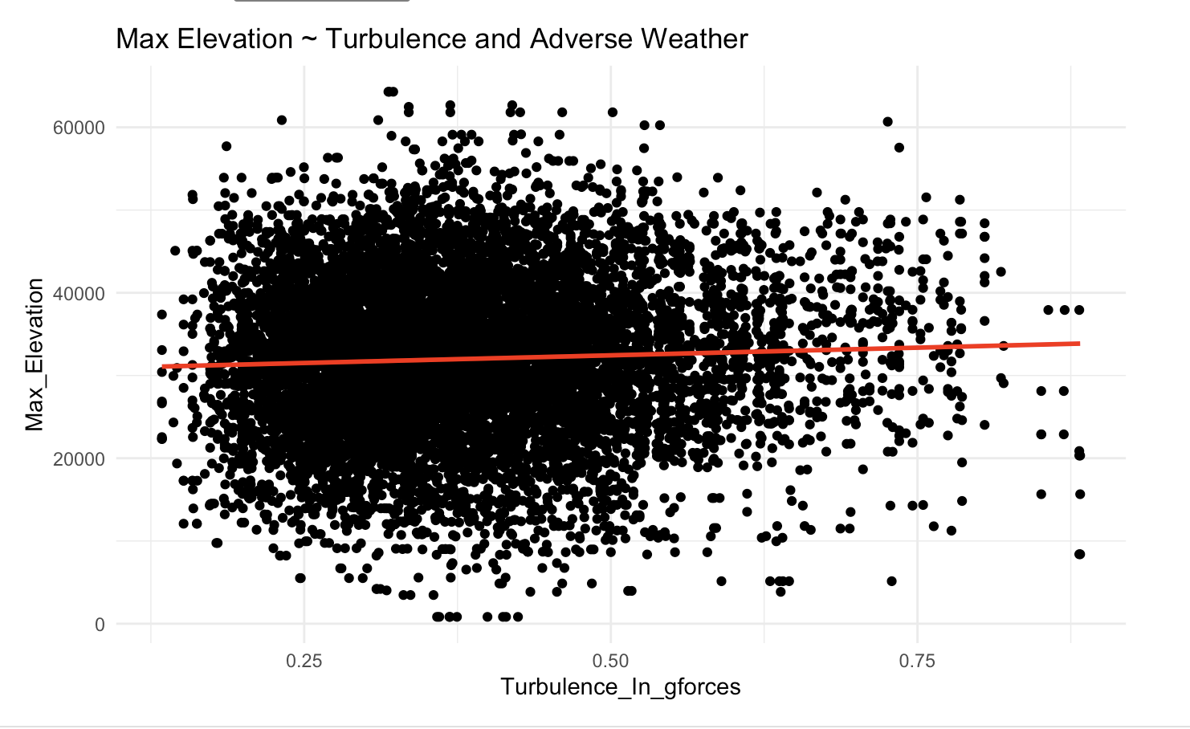
Linear Regression

